Slide 1



Zetwork
BUILD WITH THE RIGHT PEOPLE
Developer team-matching with explainable, rule-based compatibility —
five developer archetypes and a transparent 5-factor score.
Boldbaatar Bolor
Capstone Project · Cohort 2
Presented at
AI Academy Asia

Slide 2

Zetwork
THE PROBLEM
Finding people to build with is broken
01
02
03
Skills ≠ fit
Discovery is flat
No shared “why”
Two strong engineers can still clash. Stack, working style and goals all matter — but nothing measures them together.
Endless lists and filters. No intuitive way to see who sits closest to you in skill-space.
Reaching out is a cold guess. There's no language for why two developers would actually click.
Zetwork turns “who should I build with?” into a measurable, visual question.
Boldbaatar Bolor · Cohort 2 · AI Academy Asia
02

Slide 3
Zetwork
THE SOLUTION
A team-matching engine for developers
Each developer is profiled by languages, interests,
a build-goal and zodiac — then placed in a shared skill-space.
The engine labels one of five archetypes and shows exactly why two people match — then they connect & chat.
What a user gets
Instant archetype classified the moment you save
Ranked matches everyone scored 0–100 vs you
Explainable score five bars, not a black box
5
5
100%
Constellation map matches as a clickable star-field
Connect & chat requests, accept & 1:1 messaging
archetypes
match factors
explainable
Boldbaatar Bolor · Cohort 2 · AI Academy Asia
03

Slide 4
Zetwork
HOW IT WORKS
From profile to connection
01
02
03
04
05
›
›
›
›
Profile
Archetype
Score
Constellation
Connect
Languages, interests, build-goal & zodiac.
Projected & matched to nearest of 5 centroids.
Every other dev scored 0–100 against you.
Matches drawn as a clickable star-map.
Send requests, accept & message.
Runs fully offline — deterministic, instant, and fully explainable.
Boldbaatar Bolor · Cohort 2 · AI Academy Asia
04

Slide 5
Zetwork
THE MODEL
Five developer archetypes
Code Architect
BACKEND & SYSTEMS
Pixel Alchemist
UI & DESIGN
Data Oracle
AI & DATA
Ship-It Maverick
FAST PRODUCT BUILDER
Cyber Sentinel
DEVOPS & SECURITY
Boldbaatar Bolor · Cohort 2 · AI Academy Asia
05

Slide 6
Zetwork
THE ALGORITHM
A transparent 5-factor score
Tech-stack overlap
30%
Jaccard of languages & tools
Archetype fit
25%
same or complementary pairing
Interests overlap
20%
Jaccard of interest tags
Zodiac harmony
15%
element compatibility matrix
Build-goal similarity
10%
TF-IDF cosine (scikit-learn)
score = 0.30·tech + 0.25·archetype + 0.20·interests + 0.15·zodiac + 0.10·goal → 0–100
Boldbaatar Bolor · Cohort 2 · AI Academy Asia
06

Slide 7
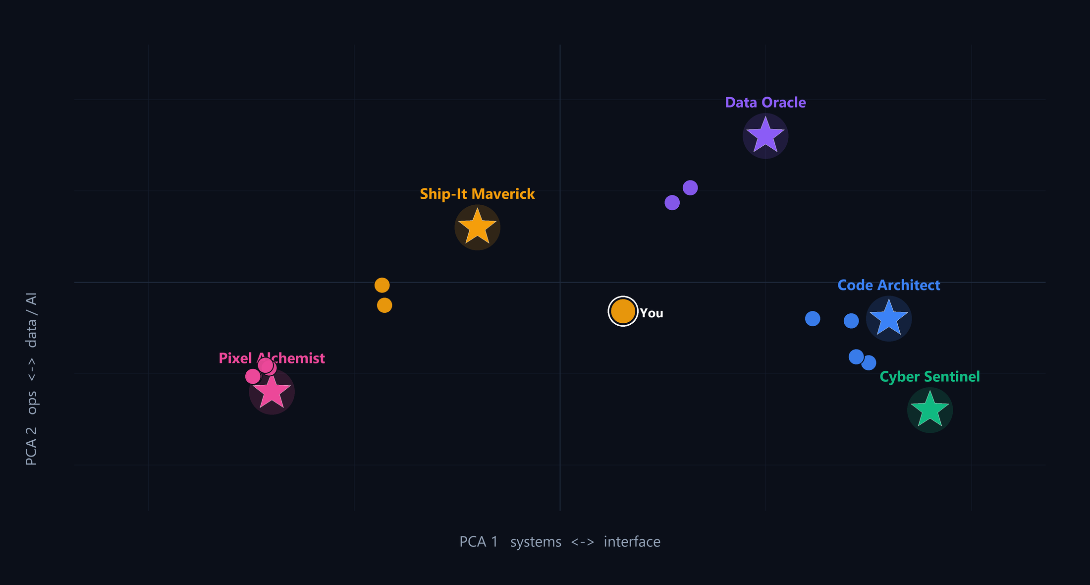
Zetwork
REAL OUTPUT
The archetype map
Every profile in the seed network, projected into the 2D skill-space.
10 / 10
seed archetypes reproduced
Nearest-centroid labels match every stored assignment — the rule is consistent, not hand-picked.
Boldbaatar Bolor · Cohort 2 · AI Academy Asia
07

Slide 8
Zetwork
REAL OUTPUT
A real match, scored
79%
Temuulen
DATA ORACLE
Munkhzul
DATA ORACLE
AI & data specialist
OVERALL COMPATIBILITY
AI & data specialist
Tech-stack
75%
Interests
75%
Archetype fit
100%
Zodiac
100%
Build-goal
16%
Boldbaatar Bolor · Cohort 2 · AI Academy Asia
08

Slide 9
Zetwork
HOW IT REALLY WORKS
Under the hood: honest & explainable
Archetypes
Projection
Five personas informed by the Stack Overflow 2024 Developer Survey (70k+ respondents). Each is a fixed point in a 2D skill-space.
Every profile is mapped to that space by keyword loadings (a PCA-style linear map), then labelled by its nearest centroid — a transparent k-means-style rule.
Scoring
Why it matters
Jaccard set-overlap + TF-IDF cosine (scikit-learn on the backend) + an element matrix, blended by fixed weights into 0–100.
Deterministic and instant — no black box. Every score traces back to its inputs, so a match can always be explained.
Boldbaatar Bolor · Cohort 2 · AI Academy Asia
09

Slide 10
Zetwork
ENGINEERING
Architecture & tech stack
Frontend
Backend
ML & Data
›
React 19 + TypeScript
›
FastAPI (Python)
›
5 survey-informed archetypes
›
Vite 6 · Tailwind v4
›
SQLAlchemy · PostgreSQL
›
PCA-style projection
›
Motion animations
›
JWT + bcrypt auth
›
Nearest-centroid labelling
›
Canvas constellation UI
›
scikit-learn (TF-IDF)
›
Jaccard + cosine scoring
Boldbaatar Bolor · Cohort 2 · AI Academy Asia
10

Slide 11
Thank you
ZETWORK · BUILD WITH THE RIGHT PEOPLE
Matching developers by skill, mindset & vibe.
Boldbaatar Bolor
Cohort 2 · AI Academy Asia

